Slide 1


This application will be implemented to 1. Create an order, 2. Modify an order, 3. Maintain a list of games. 4. Browse games as a customer wishes When the customer goes to store to purchase items, an employee uses this application to create an order, modify an order or maintain a list of games.
SERVICE GAMES-IN-STORE

Slide 2
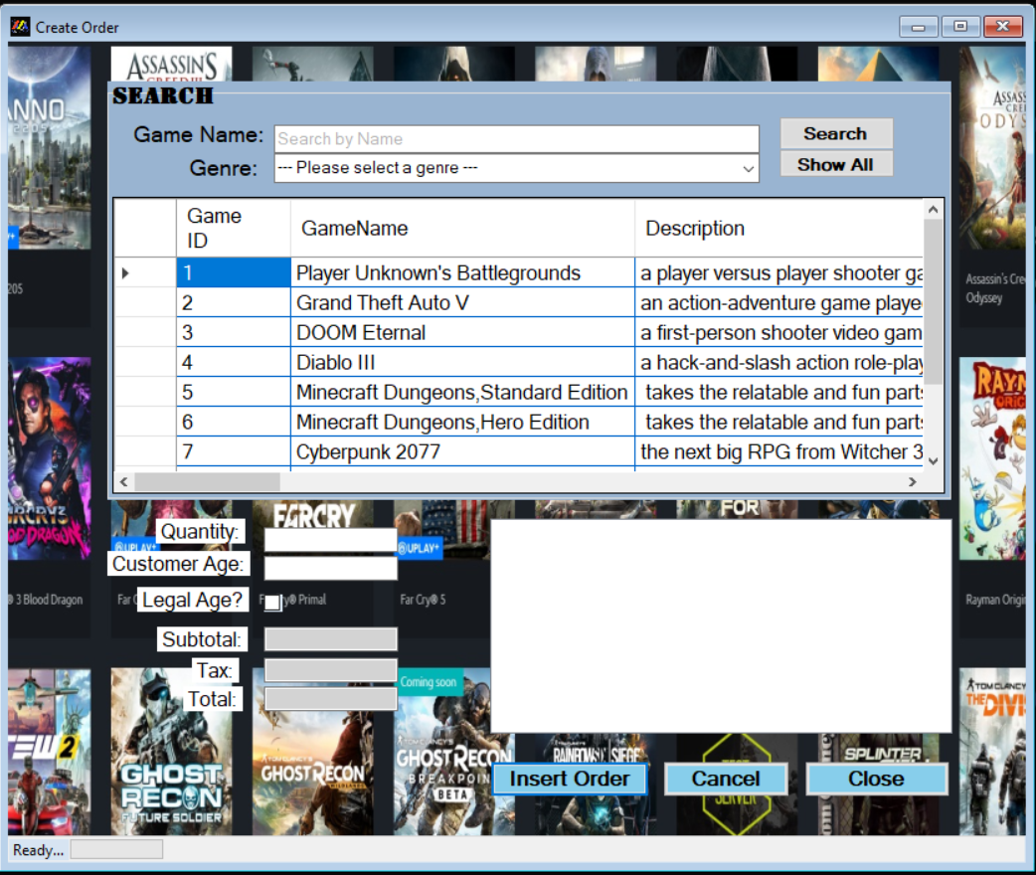
Here is the place that an employee is going to generate an order when items is selected

Slide 3
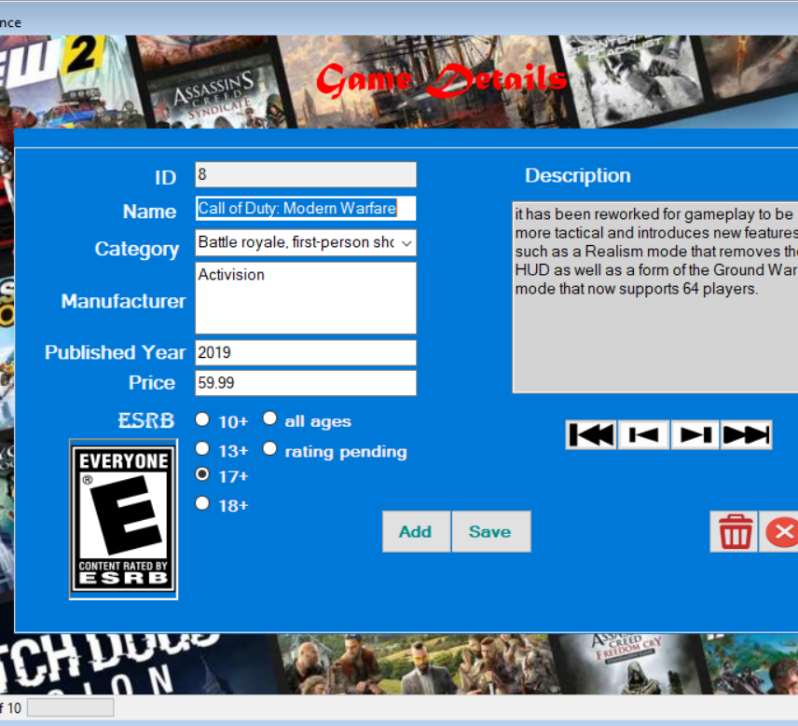
This UI is a part of application that an employee can update new games and give more information games released

Slide 4
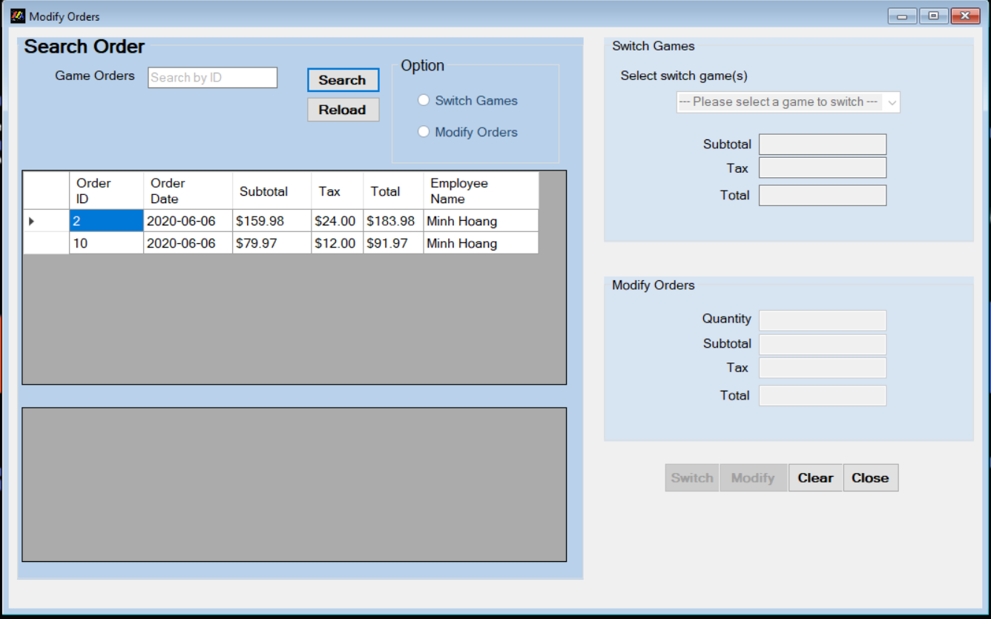
The last part in the application is order modification which has 2 options for customer s - Switch games - Modify orders’ quantity

